Slide 1
Biological Research Methods & Ethics
Learning Objectives:
3. Discuss how and why particular research methods are used at the biological level of analysis.
4. Discuss ethical considerations related to research studies at the biological level of analysis.

Slide 2
How to address the objectives…
What does DISCUSS mean?
  Describe the methods
  Give examples (research)
  Evaluate use
3. Discuss how and why particular research methods are used at the biological level of analysis.
  WHY do they use specific methods?
  WHAT are the strengths and limitations?
    In a biological context
4. Discuss ethical considerations related to research studies at the biological level of analysis.
  WHY are methods used?
  WHAT are the ethical issues?

Slide 3
THREE main research methods
Laboratory Experiments
Case Studies
Correlational Studies

Slide 4

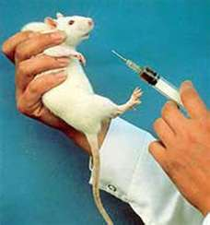
Laboratory Experiments
Establish cause and effect between variables
  Animals and humans
Limitation to using human
  Too much information can alter results
    Necessary for ethics?
    Placebo Effect
      Respond to being treated not the treatment
  How do you study brain damage? You can’t cause it in humans

Slide 5
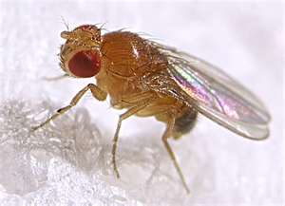
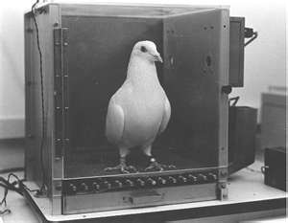
What animals are used?
Rats, pigeons and fruit flies
  Why fruit flies?
    Short life span
    Study evolution by changing environment
One view
  Lesser experience of pain
  Less conscious awareness
Closely monitored
Argument against…
  Morally wrong
  Difference in suffering is not large enough
  If they are different than us, why do we study them?

Slide 6
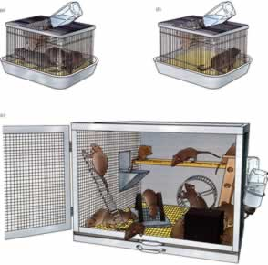
Research support
Rosenzweig

Slide 7
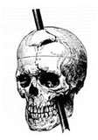
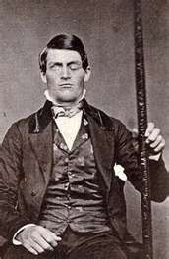
Case Studies
Study naturally occurring irregularities
  Braing damage
  Long-term drug use
  Genetic disorders
Data
  Medical context
  Change in behavior
  Brain scans
Strength: noninvasive
Limitation: no control, no clear cause and effect

Slide 8
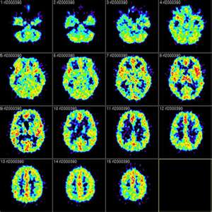
Correlational Studies
No manipulation
  Studies two or more measures and the relationship between them
Most research is twin/adoption studies
Brain Scans
  fMRI and PET scans show us the relationship between behavior, cognition or emotions and brain functions
Limitations
  Does not establish cause and effect

Slide 9

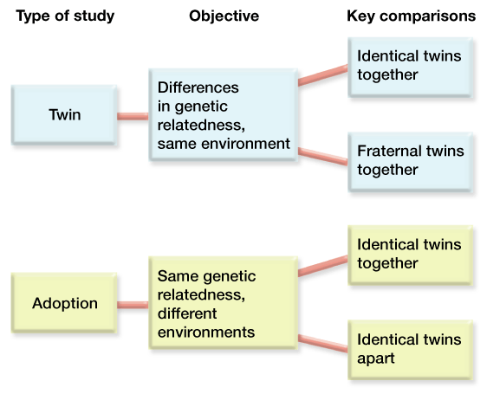
Research Support
Bouchard

Slide 10
Ethics
Must have informed consent
  Those with mental illness may not be able to
  Very few participants
    Turn to animal research (#1 argument for animal research)
Case Studies
  Unique situations make it hard to keep things anonymous

Slide 11
Write the following questions down…
Does it matter that laboratory experiments are more common than field experiments at the biological level of analysis?
How can we know if animals experience pain and suffering? Is it possible to resolve this issue logically?
As a group, answer the following questions….

